Slide 1
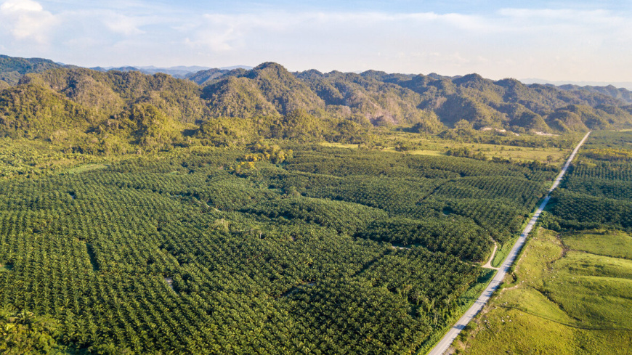
Detecting Palm Oil Plantations Using Neural Networks
Newton Tran

Slide 2
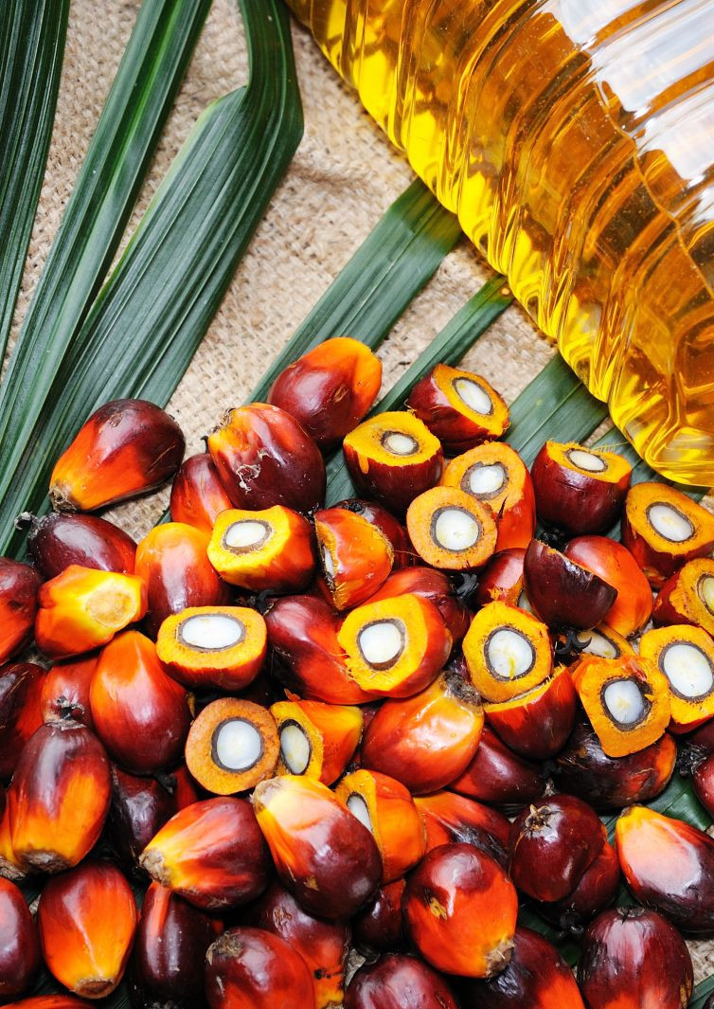
What is palm oil and why?
Elaeis guineensis or the African oil palm
Native to Africa but was brought over to Southeast Asia over a century a go as ornamental (decorative) tree crop
Highly versatile because:
Semi-solid at room temperature, keeps its spreadability
Resistant to oxidation → longer product shelf life
Relatively high smoke point of 235 °C (or 455 °F)
Odorless and colorless
Highly-efficient and high-yielding crop, doesn’t require much land
About 50% of packaged products contain it
Over 85% of the global supply is produced in Indonesia and Malaysia (Thailand, Columbia, Nigeria, etc. also)

Slide 3
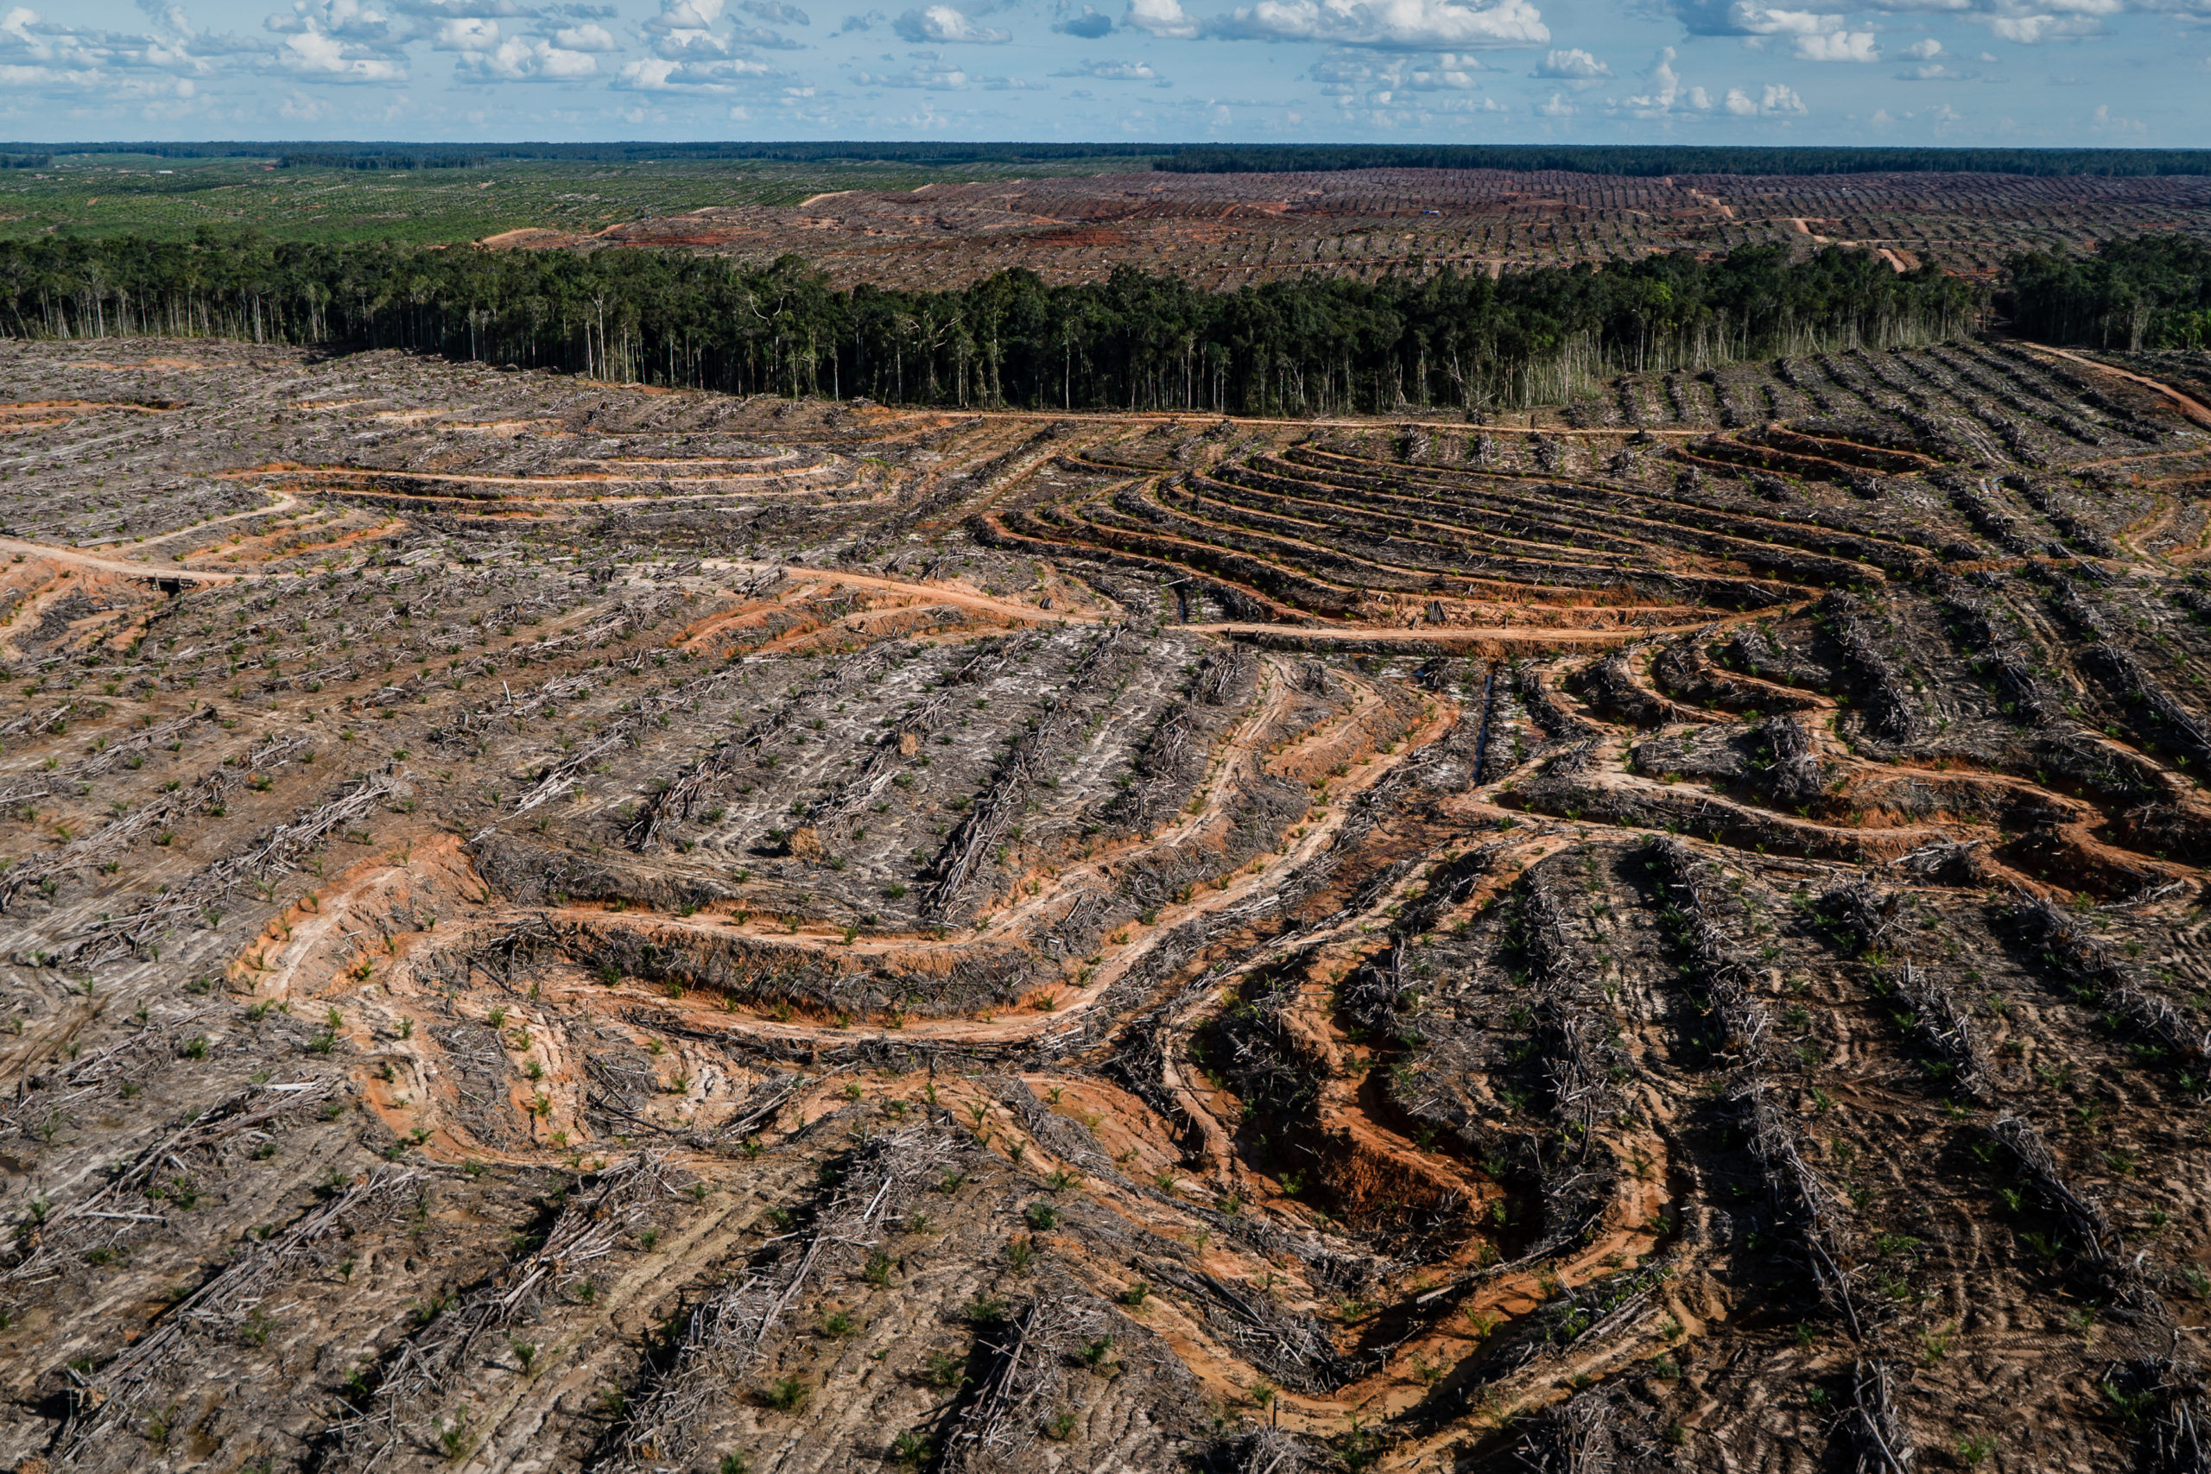
Consequences of Palm Oil
Between 2000 to 2018, palm oil accounted for 7 percent of global deforestation
Decrease in biodiversity
More carbon-rich peat soils, which emit millions of tons of carbon dioxide → further contributing to climate change

Slide 4
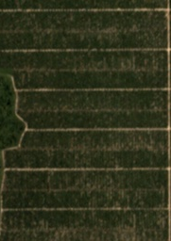
Problem Statement
Given a dataset of satellite images, can we build a model that utilizes neural networks to detect the presence of palm oil plantations?

Slide 5
Data
Women in Data Science (WiDS) Datathon 2019
Three .zip folders and their corresponding .csv annotation files:
train_images.zip, the images used for training
leaderboard_holdout_data.zip, the images used for the competition’s submission / ranking
leaderboard_test_data.zip, the images used for the competition’s submission / ranking, like above
traininglabels.csv, the annotations that correspond to training images
holdout.csv, the annotations that correspond to the holdout images
testlabels.csv, the annotations that correspond to the test images

Slide 6
Data
For each of the annotations, there are three features:
image_id, the filename of the image
has_oilpalm, where 0 indicates no presence of a palm oil plantation, 1 indicates otherwise (i.e., the image’s label)
score, which indicates the likelihood of the image’s label holding true, where values closer to 1 indicate high likelihood
More images were added after the end of the competition but were not officially documented
Test dataset was unusable since there were significantly more images than those listed in the corresponding annotations, and they deviated quite extremely
As a result, this model utilizes the training and holdout datasets

Slide 7
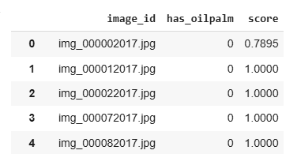
Data Preview

Slide 8
Exploratory Data Analysis
First critical thing to address is mismatch between the actual filenames and those listed in the annotations
Particularly, remove the 2017 and 2018 appended to the end of the filenames listed in the annotations
Subsequent duplicate filenames were created, so any duplicates were removed immediately
The annotations were further filtered to include only images whose filenames exactly matched

Slide 9
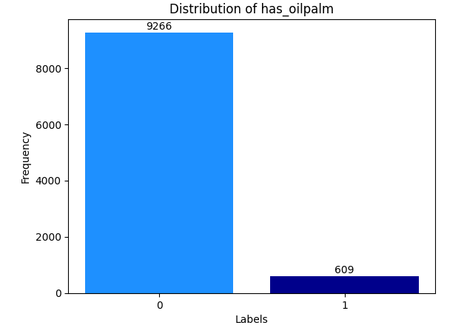
Distribution of the Training Labels, has_oilpalm
After initial preliminary cleaning, we observe that the training labels were highly imbalanced
94 percent of negative class, whereas the remaining 6 percent of positive class

Slide 10
Distribution of has_oilpalm, Relative to score
Among the negative class images, 83 percent of them contain a score of 1, indicating high likelihood of no palm oil plantation
We further investigate how score differs by looking at different thresholds:
score equals 1
score is between 0.7 inclusive and 1 non-inclusive
score is between 0.5 inclusive and 0.7 non-inclusive
score is below 0.5

Slide 11
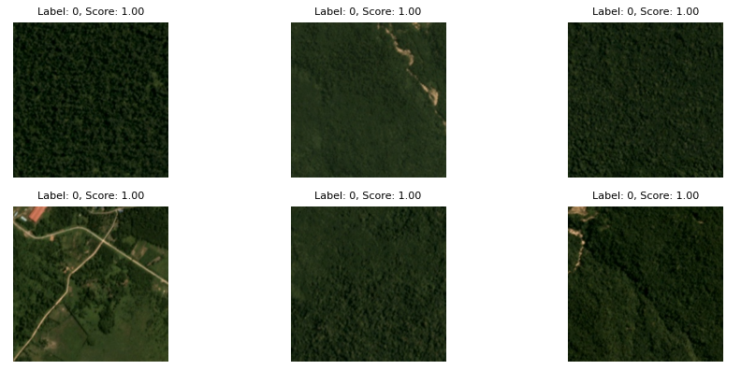
score equals 1

Slide 12
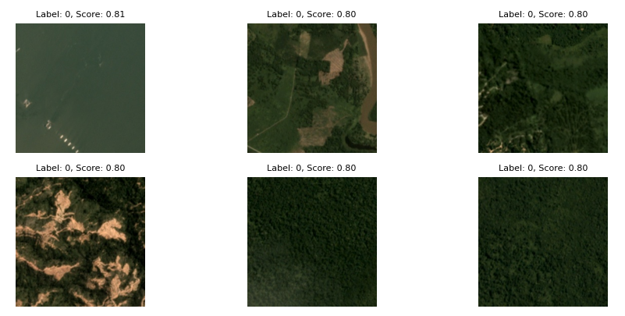
score is between 0.7 inclusive and 1 non-inclusive

Slide 13
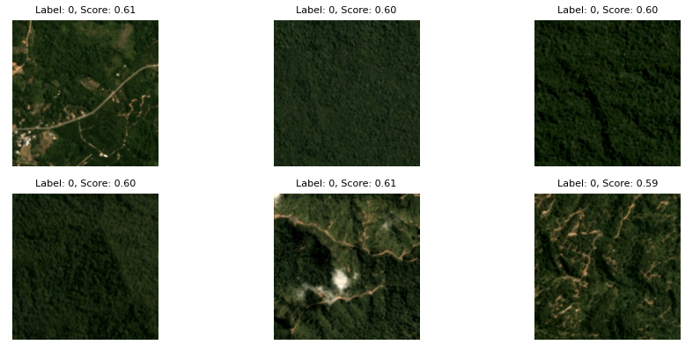
score is between 0.5 inclusive and 0.7 non-inclusive

Slide 14
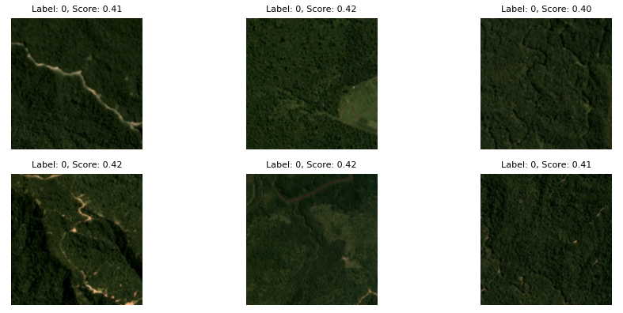
score is below 0.5

Slide 15
Distribution of has_oilpalm, Relative to score
Among the positive class images, 82 percent of them contain a score of 1, indicating high likelihood of a palm oil plantation
As done previously, we will further investigate how score differs by looking at different thresholds:
score equals 1
score is between 0.7 inclusive and 1 non-inclusive
score is between 0.5 inclusive and 0.7 non-inclusive
score is below 0.5

Slide 16
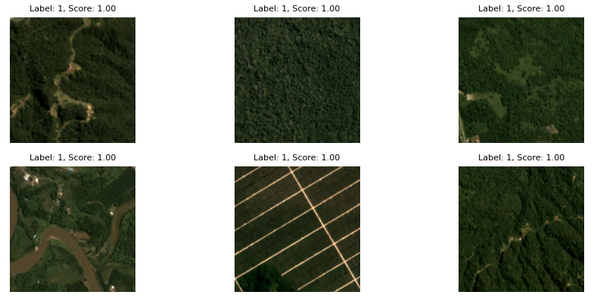
score equals 1

Slide 17
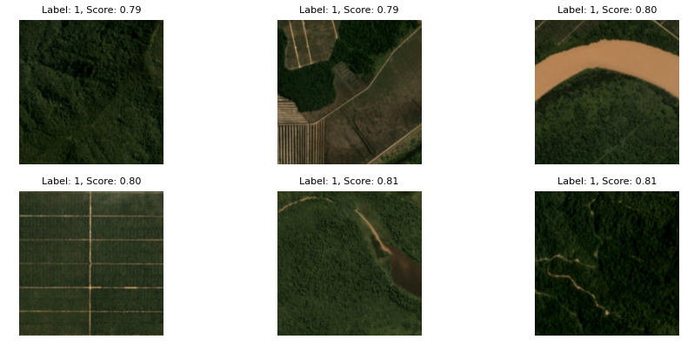
score is between 0.7 inclusive and 1 non-inclusive

Slide 18
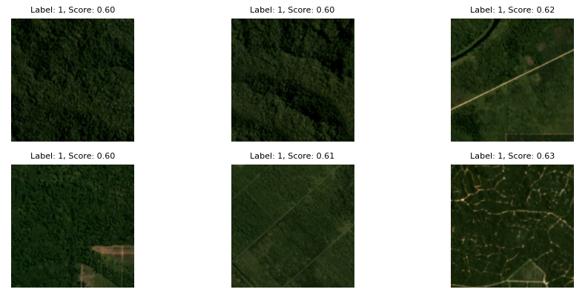
score is between 0.5 inclusive and 0.7 non-inclusive

Slide 19
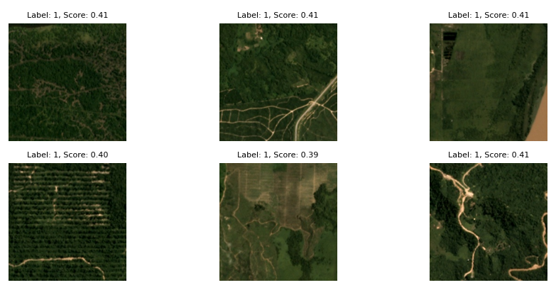
score is below 0.5

Slide 20
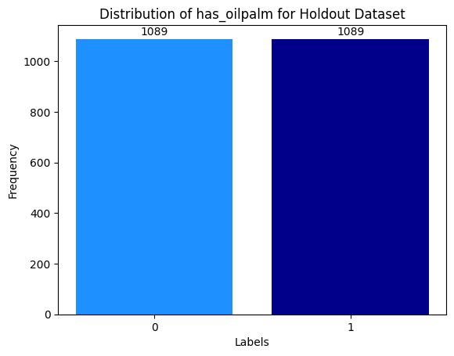
Distribution of Holdout Labels, has_oilpalm

Slide 21
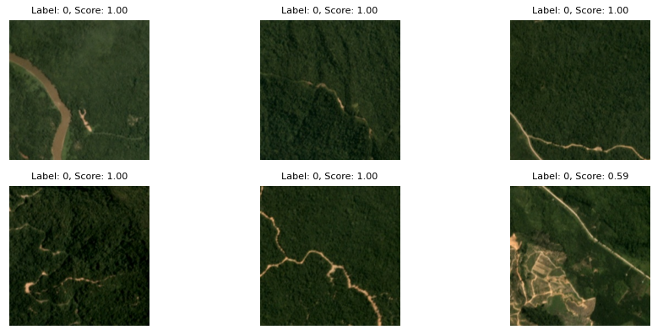
Negative Class Holdout Images

Slide 22
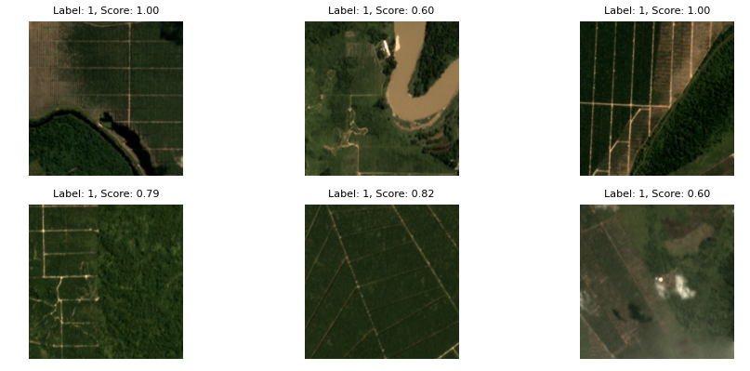
Positive Class Holdout Images

Slide 23
Data Wrangling
Since the dataset was highly imbalanced, both underampling of the negative class and oversampling of the positive class were utilized
Establish two criteria for score:
For the negative class images, set score equal to 1
For the positive class images, set score greater than or equal to 0.5
These two criteria ensure robustness to our dataset

Slide 24
Data Wrangling
After filtering the dataset with these two criteria, 7671 negative class images and 593 positive class images were obtained
Finally, the negative class images were downsampled to 5930 and the positive class images were oversampled to 5930 via augmentation

Slide 25
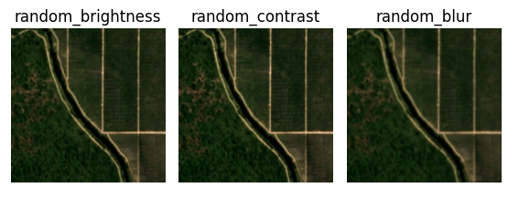
Data Augmentation

Slide 26
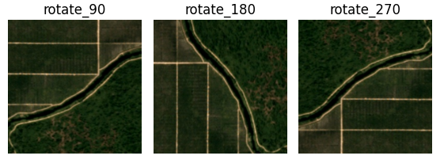
Data Augmentation

Slide 27
Data Augmentation
Retain as much of the original image as possible while adding robustness
Variations in color, lighting, and overall image quality
Resulting images are rather subtle, especially for the random brightness, random contrast, and random blur transformations
Since the model uses VGG-19 (a pre-trained neural network), the images needed to be preprocessed in a specific manner, namely via the preprocess_input from tensorflow.keras.applications.vgg19
Each image was resized to (224, 224) with 3 color channels
Serialized and zipped using gzip and pickle libraries

Slide 28
Modeling
Serialized and zipped images were unloaded for modeling
Training data was train-test split via 80/20 stratified split, then further split into training and validation using another 80/20 stratified split
VGG-19 was utilized (i.e., using transfer learning)
A pre-trained neural network that consists of 16 convolutional and 3 fully connected layers and trained from over 1 million images from the ImageNet collection
Initial layers were frozen to leverage its feature extraction capabilities, to help find certain patterns in the satellite mages
We also introduce our own custom layers since this model was not trained on satellite images

Slide 29
Modeling
Layer Type | Details
Pretrained base | VGG-19 (frozen)
Flatten | Converts extracted features (multi-dimensional) to one-dimensional
Dense 1 | 300 neurons, ReLu, Kaiming normal initialization
Dropout 1 | 40%
Dense 2 | 200 neurons, ReLu, Kaiming normal initialization
Dropout 2 | 30%
Dense 3 | 100 neurons, ReLu, Kaiming normal initialization
Dropout 3 | 25%
Dense 4 | 50 neurons, ReLu, Kaiming normal initialization
Dropout 4 | 25%
Dense 5 | 25 neurons, ReLu, Kaiming normal initialization
Dropout 5 | 20%
Output Layer | 1 neuron, Sigmoid, L2 Regularization

Slide 30
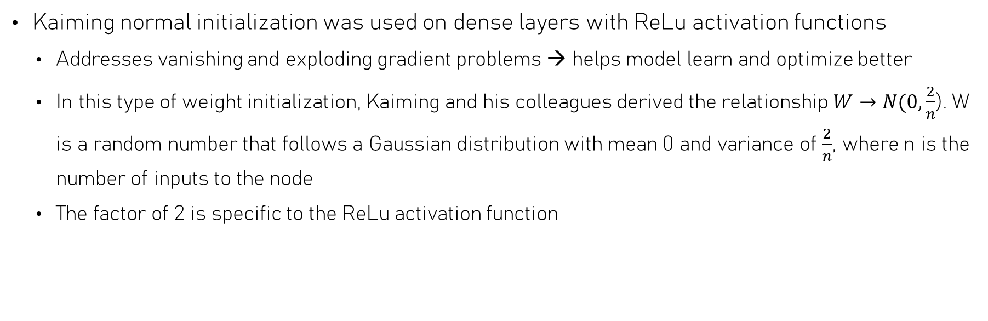
Kaiming Normal Initialization
Kaiming normal initialization was used on dense layers with ReLu activation functions
Addresses vanishing and exploding gradient problems → helps model learn and optimize better
In this type of weight initialization, Kaiming and his colleagues derived the relationship$W→N(0, \frac{2}{n}$). W is a random number that follows a Gaussian distribution with mean 0 and variance of $\frac{2}{n}$, where n is the number of inputs to the node
The factor of 2 is specific to the ReLu activation function

Slide 31
L2 Regularization
Aka Ridge regularization or weight decay
Unlike L1 regularization which pushes the weights to zero, which in turn promotes sparsity, L2 regularization pushes the weights to be small but not zero
Beneficial since:
Smaller weights reduce model complexity and overfitting
Weights are more evenly distributed (i.e., prevents cases where some weights are much larger than others)
Better numerical stability, especially when there is multicollinearity or when features are highly correlated with each other
Improves interpretability by reducing the influence of less important features
Only applied to final dense layer to prevent over-regularization, which can hinder model’s performance

Slide 32
AdamW Optimizer
AdamW was used with learning_rate = 1e-4 and weight_decay = 5e-5
In Adam, the weight decay is applied indirectly when updating gradients, which can unintentionally modify the model’s adaptive learning capabilities and interfere with the optimization process
AdamW separates the weight decay from the gradient step, which ensures regularization impacts the parameters without altering the model’s adaptive learning capabilities
In turn, this helps regularize models more precisely and helps models generalize better

Slide 33
Custom Callback
A custom callback was used to keep record of several metrics evaluated on the holdout dataset, namely:
Precision scores of both classes
Recall scores of both classes
F1 scores of both classes
ROC-AUC score across epochs
Average precision (AP) score
Optimize for the highest ROC-AUC score and AP score (since dataset was originally imbalanced)

Slide 34
Grid Search with Number of Epochs and L2 Regularization Values
A grid search was done to determine the best-performing pair of hyperparameters
In this case, the number of epochs and an L2 regularization value
epoch_values = [3, 4]
l2_values = [0.03851, 0.03852, 0.03853, 0.03854, 0.03855]
In earlier iterations, the model would begin overfitting after about 6 epochs, and L2 regularization values between 0.038 and 0.039 yielded the best results

Slide 35
Grid Search with Number of Epochs and L2 Regularization Values
While it was important to optimize for the highest ROC-AUC score and AP score, the condition used to determine the best-performing model was the average F1 score
avg_f1_score = (f1_class_0 + f1_class_1) / 2
We want to minimize both type I (predicting the presence of a palm oil plantation when there is none) and type II (predicting no presence of a palm oil plantation when there is) errors
The best-yielding hyperparameters were epoch = 3 and l2_value = 0.03851

Slide 36
Grid Search with Number of Epochs and L2 Regularization Values
The best model yielded from the grid search produced a holdout ROC-AUC score of 0.9545 and a holdout AP score of 0.9588
This model was then saved and subsequently trained (fine-tuned) for 2 additional epochs and the learning rate for the AdamW optimizer was lowered, where learning_rate = 1e-5
The final model yielded a holdout ROC-AUC score of 0.9701 and a holdout AP score of 0.9721.

Slide 37
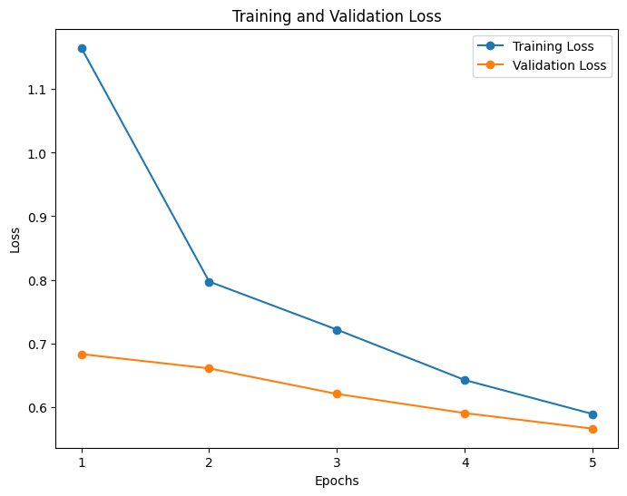
Training and Validation Losses

Slide 38
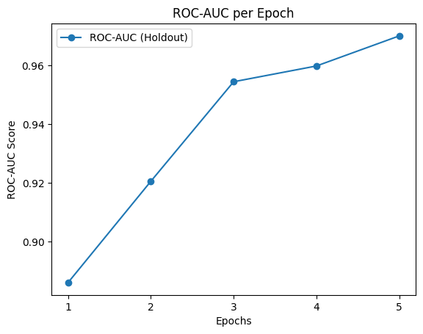
ROC-AUC Score per Epoch

Slide 39
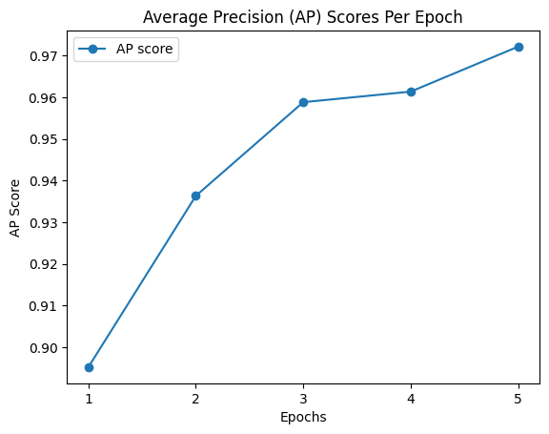
AP Score per Epoch

Slide 40
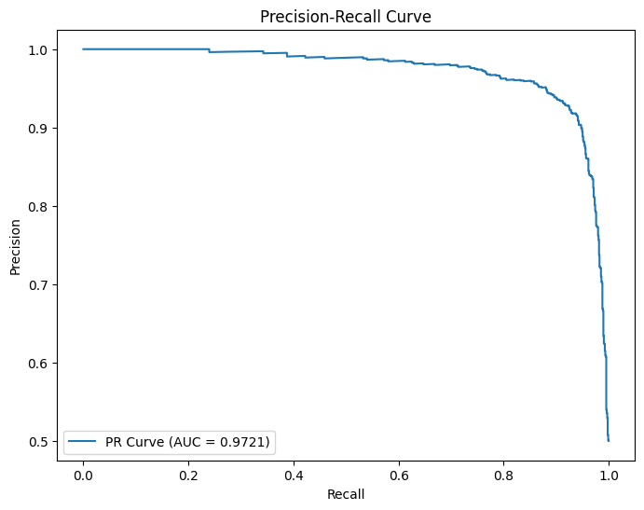
Precision-Recall Curve

Slide 41
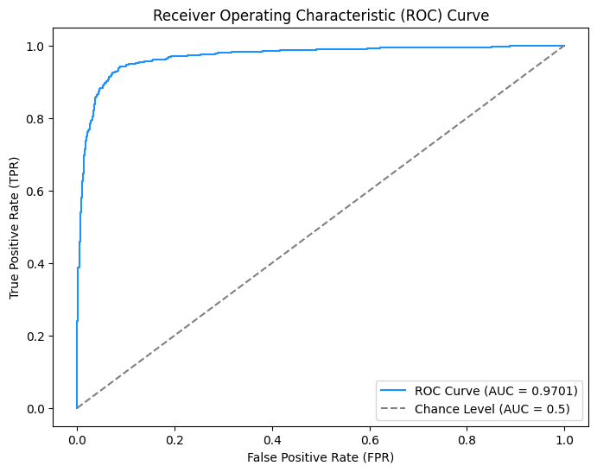
ROC Curve

Slide 42
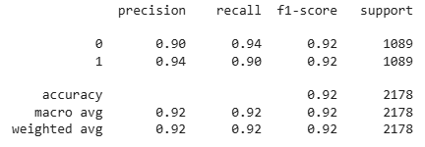
Classification Report

Slide 43
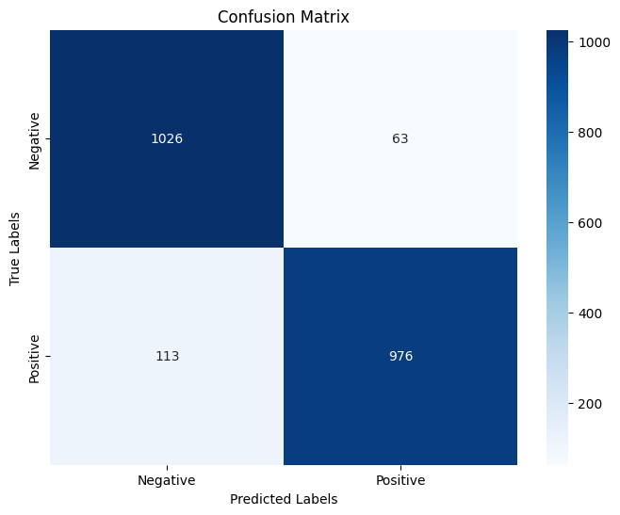
Confusion Matrix

Slide 44
Results
Both training and validation losses decreased together and start to converge to similar levels after the fifth epoch
Both ROC-AUC and AP scores increased after each epoch → model progressively improved
Both metrics were considerably high since both were close to 1
For the confusion matrix, the model predicted 94% of the negative class and 90% of the positive class correctly, also achieving an F1 score of 0.92 for both classes

Slide 45
Conclusion
Model yielded remarkable results due to data augmentation, hyperparameter tuning, and fine-tuning
Effectively addressed class imbalance and prevent overfitting
Adapt VGG-19 to our unique problem
Future considerations include:
Try another pretrained model like ResNet-50
Readjust augmentation for the positive-class images
Setting different threshold for score for the positive class images at greater than or equal to 0.6
Random grid search to save on time and computational costs

Slide 46
References
WWF. “8 Things to Know about Palm Oil.” WWF, WWF, 12 Nov. 2018, www.wwf.org.uk/updates/8-things-know-about-palm-oil.
“Palm Oil | USDA Foreign Agricultural Service.” Usda.gov, 2024, www.fas.usda.gov/data/production/commodity/4243000.
‌Pykes, Kurtis. “AdamW Optimizer in PyTorch Tutorial.” Datacamp.com, DataCamp, 21 Oct. 2024, www.datacamp.com/tutorial/adamw-optimizer-in-pytorch.
‌MathWorks. “Mel Frequency Cepstral Coefficients.” Mathworks.com, 2020, www.mathworks.com/help/audio/ref/cepstralcoefficients.html, https://doi.org/1061245463.woff2.
“Global Deforestation Slowing but Tropical Rainforests Remain under Threat, Key FAO Report Shows.” Newsroom, 5 Mar. 2022, www.fao.org/newsroom/detail/global-deforestation-slowing-but-rainforests-under-threat-fao-report-shows-030522/en.

Slide 47
References
Vaj, Tiya. “Why We Freeze Some Layers for Transfer Learning - Tiya Vaj - Medium.” Medium, 24 Jan. 2024, vtiya.medium.com/why-we-freeze-some-layers-for-transfer-learning-f35d9f67f99c.
“VGG-Net Architecture Explained.” GeeksforGeeks, 7 June 2024, www.geeksforgeeks.org/vgg-net-architecture-explained/.
‌“Kaiming Initialization in Deep Learning.” GeeksforGeeks, 27 Dec. 2023, www.geeksforgeeks.org/kaiming-initialization-in-deep-learning/.
‌GeeksforGeeks. “L1/L2 Regularization in PyTorch.” GeeksforGeeks, 31 July 2024, www.geeksforgeeks.org/l1l2-regularization-in-pytorch/. Accessed 7 Feb. 2025.
‌Brownlee, Jason. “A Gentle Introduction to Dropout for Regularizing Deep Neural Networks.” Machine Learning Mastery, 3 Dec. 2018, machinelearningmastery.com/dropout-for-regularizing-deep-neural-networks/.

